Slide 1
^{Chapter 4} Hash Tables
ZAMAN UNIVERSITY
Data Structures and Algorithms

Slide 2
Outline
Hash Tables
Quadratic Probing
Separate Chaining
When to Use What

Slide 3
Outline
Hash Tables
Quadratic Probing
Separate Chaining
When to Use What

Slide 4
Hash Tables: Introducing to Hashing
A hash table is a data structure that offers very fast insertion and searching, takes constant time O(1)
It’s so fast to look up tens of thousands of items in less than a second
Hash tables do have several disadvantages:
Developed based on arrays, difficult to expand after they’ve been created;
Performance might degrade catastrophically when the table becomes too full;
Thus, programmer needs to have a fairly accurate idea of how many data items will need to be stored;
There’s no convenient way to visit the items in a hash table in any kind of order (such as from smallest to largest).

Slide 5
Hash Tables: Introducing to Hashing (cont.)
One important concept is how a range of key values is transformed into a range of array index values
In a hash table this is accomplished with a hash function
However, for certain kinds of keys, no hash function is necessary; the key values can be used directly as array indices

Slide 6
Hash Tables: Employee Numbers as Keys
Suppose you’re writing a program to access employee records for a small company with, say, 1,000 employees
Each employee record requires 1,000 bytes of storage
The company’s director has specified that she wants the fastest possible access to any individual record
Also, every employee has been given a number from 1 (for the founder) to 1,000 (for the most recently hired worker)
These employee numbers can be used as keys to access the records
What sort of data structure should you use in this situation?

Slide 7
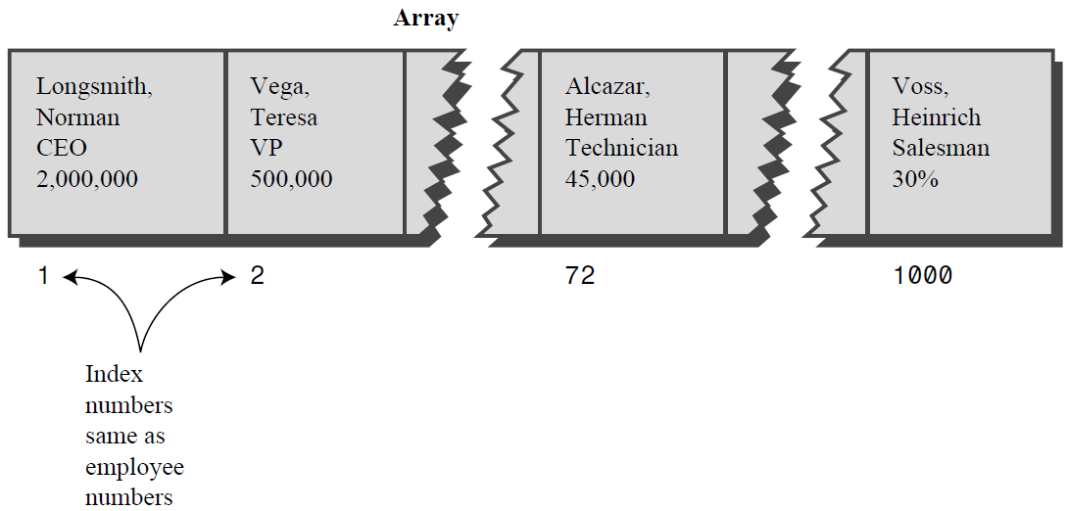
Hash Tables: Keys Are Index Numbers
Each employee record occupies one cell of the array, and the index number of the cell is the employee number for that record
Accessing a specified array element is very fast if you know its index number
Example: We are looking for Herman Alcazar, his employee number 72.
empRecord rec = databaseArray[72];

Slide 8
Hash Tables: A Dictionary
We want to store a 50.000-word English-language dictionary in main memory
You would like every word to occupy its own cell in a 50,000-cell array, so you can access the word using an index number
This will make access very fast
But what is the relationship of these index numbers to the words? Given the word, how do we define its index number?

Slide 9
Hash Tables: Converting Words to Numbers
What we need is a system for turning a word into an appropriate index number
ASCII code runs from 0 to 255, to accommodate capitals, punctuation, and so on
There are really only 26 letters in English words, so let’s devise our own code: Let’s say blank is 0, a is 1, b is 2, c is 3, and so on up to 26 for z

Slide 10
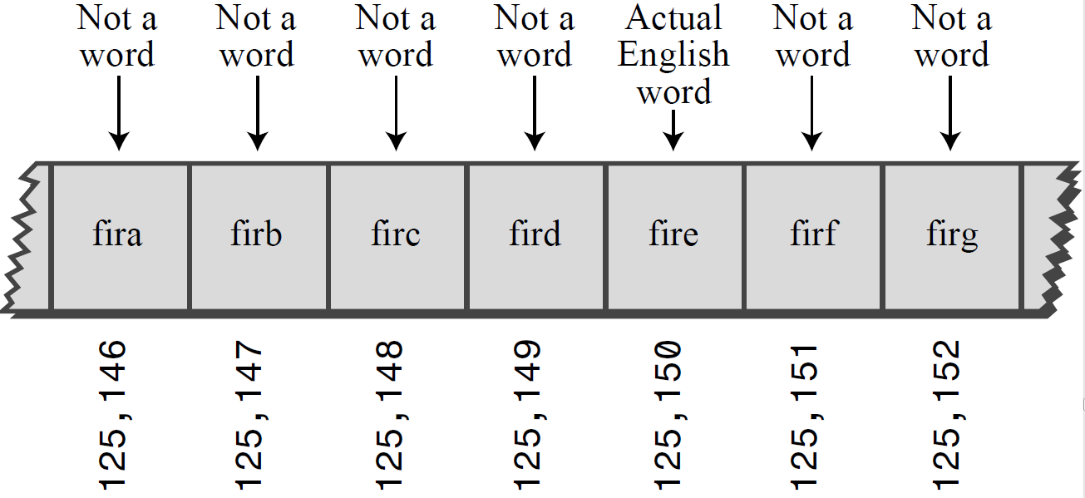
Hash Tables: Converting Words to Numbers (cont.)
Add the digits: convert cats to a number. First we convert character to number: c=3, a=1, t=20, s=19, thus we add them: 3+1+20+19=43
Multiply by Powers: different way to map words to number. Examples:
Analogous situation, define index of number instead of word
thus, 7546 means: 7*10³ + 5*10²+4*10¹+6*10⁰
Convert the word cats to a number. The result:
3*27³+1*27²+20*27¹+19*27⁰=60,337

Slide 11
Hash Tables: Hashing
arrayIndex = hugeNumber % arraySize;
It hashes (converts) a number in a large range into a number in a smaller range
This smaller range corresponds to the index numbers in an array
An array into which data is inserted using a hash function is called a hash table.

Slide 12
Hash Tables: Collisions
Perhaps you want to insert a new word into the array
You hash the new word to obtain its index number, but find that the cell at that number is already occupied by another word, which happens to hash to the exact same number (for a certain size array).

Slide 13
Linear Probing
In linear probing we search sequentially for vacant cells when a collision occurs
Example: If 5,421 is occupied when we try to insert cats there, we go to 5,422, then 5,423, and so on, incrementing the index until we find an empty cell.
This is called linear probing because it steps sequentially along the line of cells, probing for an empty cell.

Slide 14

Create a Hash Table with size 200
Create Has Function to convert words to number by Multiply Powers for Insertion and Searching.
Using Linear Probing to solve collision problem.

Slide 15
Outline
Hash Tables
Quadratic Probing
Separate Chaining
When to Use What

Slide 16
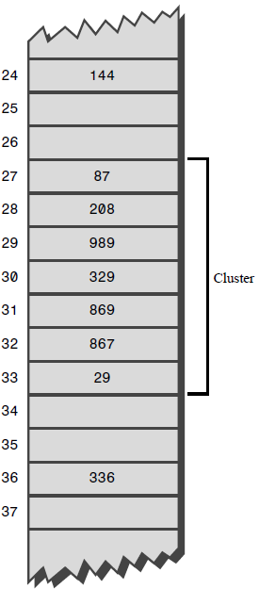
What Is Clustering?
A sequence of filled cells in a hash table called filled sequence
As you add more and more items, the filled sequences become longer
This is called clustering

Slide 17
Quadratic Probing
Quadratic probing is an attempt to keep clusters from forming
The idea is to probe more widely separated cells, instead of those adjacent to the initial hash site
The step is the square of the step number
In quadratic probing, probes go to x+1, x+4, x+9, x+16, x+25, and so on;
It means that the distance from the initial site is the square of the step number, so the probes fall at x+1² , x+2², x+3², x+4², x+5² and so on.

Slide 18
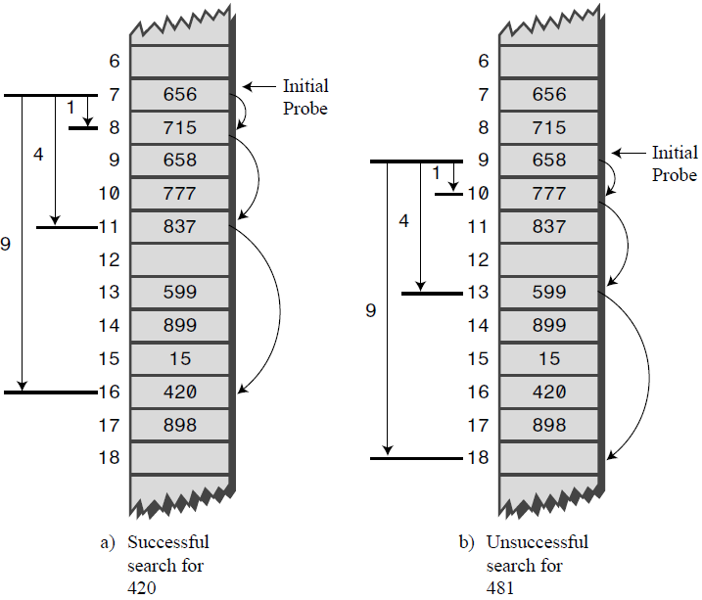
Example: Searching by Quadratic Probing

Slide 19
Problems with Quadratic Probing
Quadratic probes eliminate the clustering problem in linear probe, which is called primary clustering
However, the quadratic probe always generates the same steps: 1, 4, 9, 16, and so on, this is called secondary clustering.
To eliminate secondary and primary clustering, another approach can be used: double hashing (sometimes called rehashing)

Slide 20
Double Hashing
What we need is a way to generate probe sequences that depend on the key instead of being the same for every key
Then numbers with different keys that hash to the same index will use different probe sequences
Experience has shown that this secondary hash function must have certain characteristics:
It must not be the same as the primary hash function;
It must never output zero (otherwise there would be no step; every probe would land on the same cell).
Experts have discovered that functions of the following form work well:
stepSize = constant - (key % constant);
where constant - prime and smaller than the array size.
For example: stepSize = 5 - (key % 5);

Slide 21
Create a Hash Table with size 200
Words are converted to number by Multiply Powers;
Collision problem is solved by:
Using Quadratic Probing;
Using Double Hashing.

Slide 22
Continue…

